Slide 1


Adidas Sales Performance Analysis-EXCEL
Unlocking Growth: Data-Driven Insights for Marketing, Distribution, and Outlet Strategy.
Presented by -Suman Saha
Data Analyst
08-08-2025

Slide 2

Introduction
Why We're Here Today
Problem Statement
Objective
Our Goal
Adidas faces challenges in optimizing sales performance across diverse markets and product lines.
Analyze sales data to identify key trends, understand customer demand, and assess regional performance.
Deliver actionable insights to enhance decision-making in marketing, product distribution, and retail outlet strategies.

Slide 3
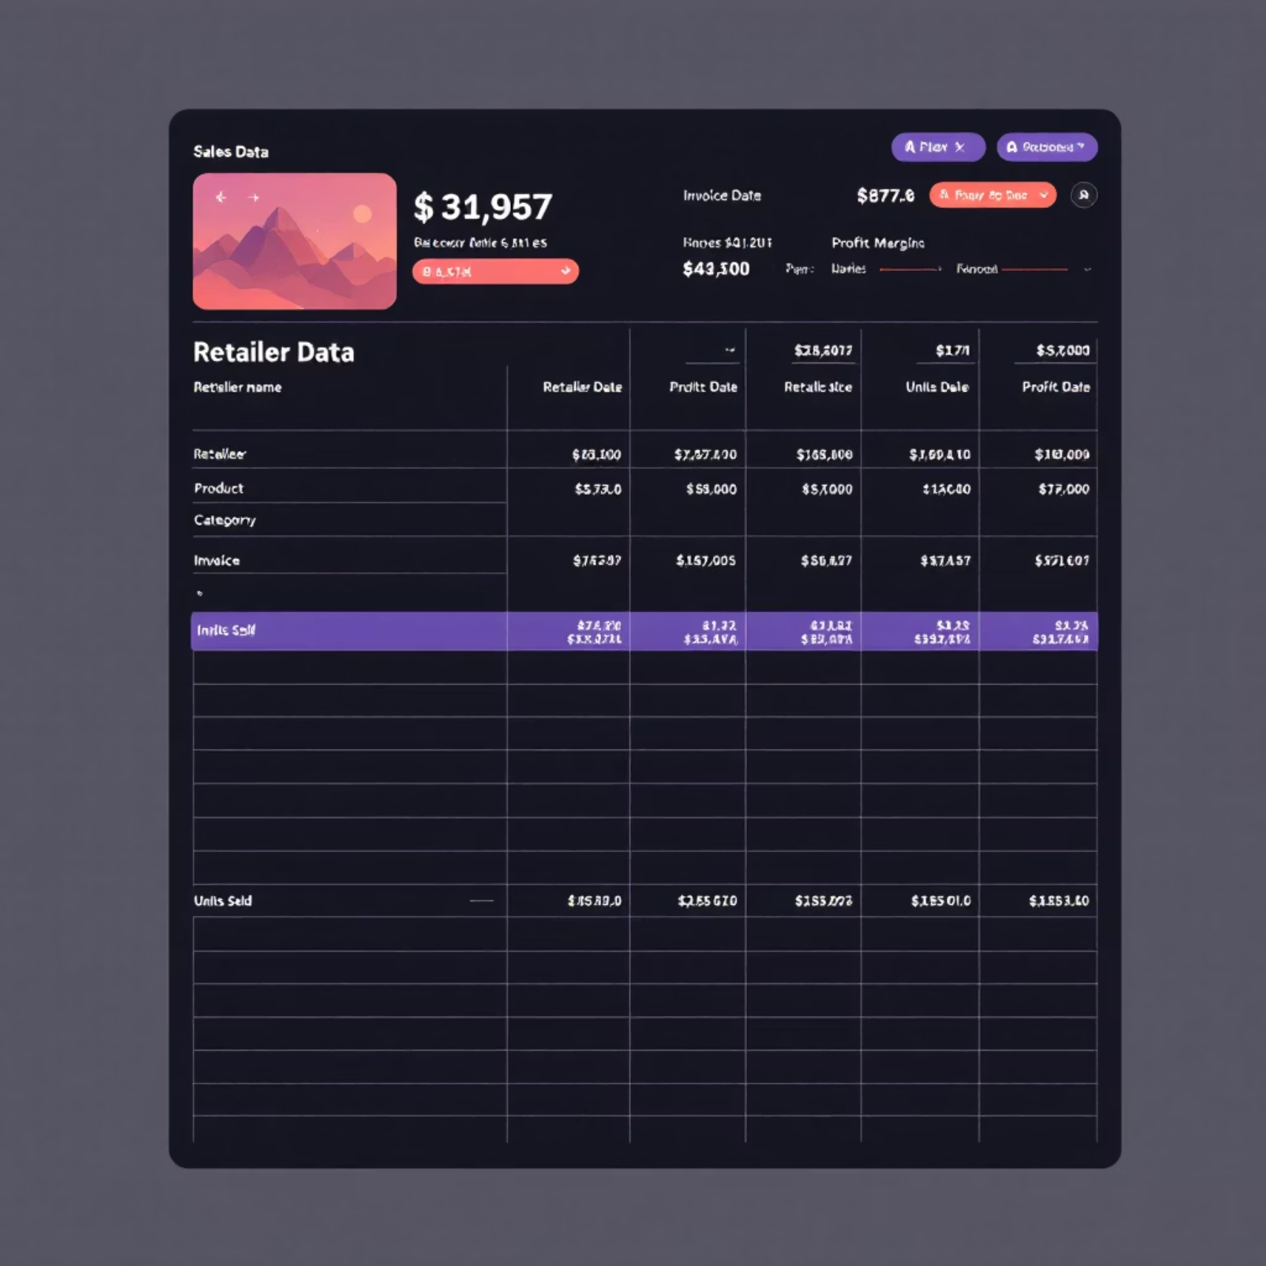
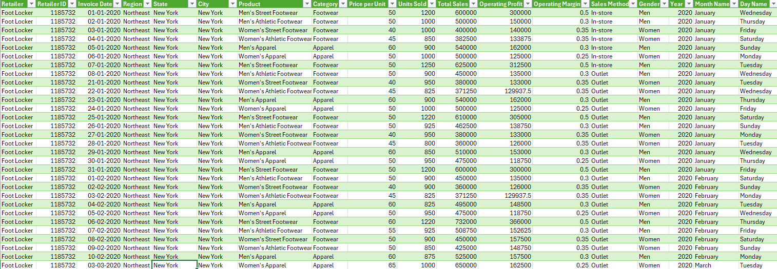
Methodology
Our Data: The Foundation of Our Analysis
Dataset Overview
Our analysis is based on the comprehensive Adidas Sales Dataset, covering multiple years of transactions.
It includes critical information from various Retailers, Product Categories, and Geographic Regions, along with detailed Sales, Profit, and Unit Sold metrics.

Slide 4
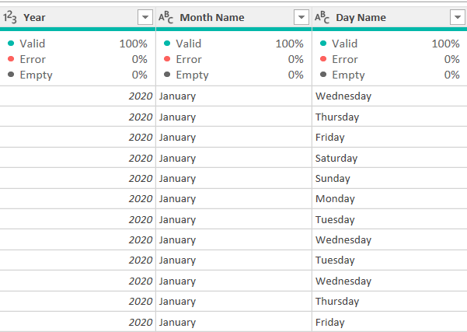
Data Preparation
We performed rigorous data cleaning: removed null values, dropped duplicates, and standardized categorical data.
Cleanse & Standardize
1
Remove nulls/duplicates, standardize product and city names.
Key data types were converted for accuracy, and new columns like Year, Month, and Profit Margin % were added for deeper analysis.
Convert Datatypes
2
Ensure proper formatting for dates, units, sales, and profit.
Enrich Data
3
Add Year, Month, and calculated Profit Margin % for insights.

Slide 5








Analysis Framework
Key Performance Indicators
Total Sales
$ 900M
Total No Of Orders
2478861
Our analysis focuses on these crucial metrics to provide a holistic view of Adidas's sales health:
Total Sales
Total Units Sold
Avg. Operating Margin %
Overall revenue generated.
Volume of products moved.
Profitability per sale.
Average Of Operating Margin
Top Retailer/Region
Monthly Sales Growth %
Top Retailer
42.30%
West Gear
Leading contributors by sales.
Rate of revenue expansion.

Slide 6
Exploratory Data Analysis
Uncovering Trends: Questions We Explored
Which products and categories generate the most sales?
Which regions and states contribute the most revenue?
How does profit margin vary across retailers?
Are there seasonal trends in sales (month-wise analysis)?
Does Units Sold correlate with Profit or Sales?

Slide 7
Visualizing Data
Sales by Product Category
Men's Apparel leads with $25M in sales, followed by Women's Footwear at $20M. Athletic Accessories and Outdoor Gear show significant potential for targeted growth strategies.

Slide 8
Visualizing Data
Monthly Sales Trend & Seasonality
Sales exhibit a clear upward trend throughout the year, peaking in the holiday season (November-December). A notable dip is observed mid-year, suggesting opportunities for off-peak promotions.

Slide 9



Key Insights
What the Data Tells Us
Top Performers
Underperforming Regions
Retailer Variance
Men's Apparel and the Midwest Region are primary sales drivers.
Foot Locker consistently outperforms, indicating strong partnership potential.
Regions like the Southeast require focused attention and optimized distribution.
Seasonal Peaks
Margin Insights
Sales significantly surge in Q4, driven by holiday demand.
High sales don't always equate to high profit; operating margin analysis is critical.

Slide 10
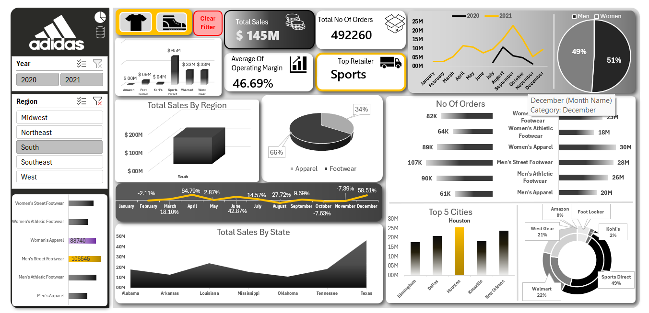
Dashboard

Slide 11






Recommendations
Actionable Strategies for Growth
Optimize Top Categories
Focus expansion efforts for high-performing product categories in leading regions.
Target Underperforming Areas
Improve distribution and marketing in regions that show lower revenue contribution.
Strengthen Retailer Partnerships
Deepen collaboration with top-performing retailers to leverage their success.
Dynamic Pricing & Sourcing
Adjust pricing or supplier strategies based on detailed profit margin insights.
Strategic Promotions
Plan marketing campaigns and promotions to capitalize on seasonal demand peaks.
Smart Stock Planning
Monitor units sold vs. sales to optimize inventory and prevent overstocking/understocking.

Slide 12

Thank You!

